Slide 1

Thymeleaf & Validation
Thymeleaf Helpers, Validators
SoftUni Team
Technical Trainers
Software University
https://softuni.bg

Slide 2
Table of Content
Thymeleaf Helpers
Dates
Strings
Numbers
Aggregates
Validations

Slide 3
Have a Question?
sli.do #java-web

Slide 4
Thymeleaf Helpers

Slide 5




Helpers
Objects that provide built-in functionalities that helps you enhance your view
Dates
Strings
List
Thymeleaf
Numbers

Slide 6
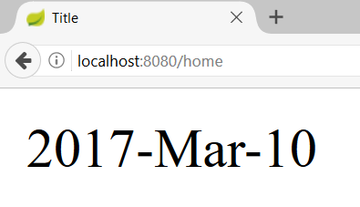
Date – Custom Format
WhiskeyController.java
@GetMapping("/home")
public String getHomePage(Model model){
model.addAttribute("myDate", new Date());
return "whiskey-home";
}
Format Date
whiskey-home.html
<div th:text="${#dates.format(myDate,'yyyy-MMM-dd')}"></div>

Slide 7
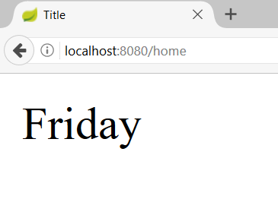
Date – Week Name of Day
WhiskeyController.java
@GetMapping("/home")
public String getHomePage(Model model){
model.addAttribute("myDate", new Date());
return "whiskey-home";
}
Day Name
whiskey-home.html
<div th:text="${#dates.dayOfWeekName(myDate)}"></div>

Slide 8
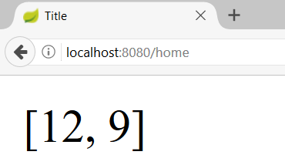
Date – List Days
WhiskeyController.java
@GetMapping("/home")
public String getHomePage(Model model){
// List of dates -> 2016-12-12, 2017-04-09 -> yyyy-MM-dd
model.addAttribute("myDates", myDates);
return "whiskey-home";
}
List Days
whiskey-home.html
<div th:text="${#dates.listDay(myDates)}"></div>

Slide 9
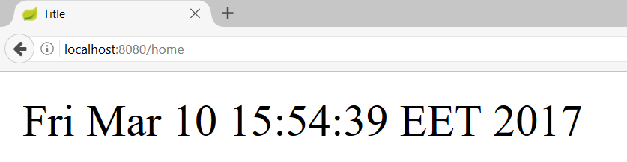
Date – Get Current Date
WhiskeyController.java
@GetMapping("/home")
public String getHomePage() {
return "whiskey-home";
}
Today’s Date
whiskey-home.html
<div th:text="${#dates.createNow()}"></div>

Slide 10
LocalDate and Thymeleaf
To use LocalDate we need to add new dependency
WhiskeyController.java
@GetMapping("/home")
public String getHomePage(Model model){
model.addAttribute("myDate", LocalDate.now());
return "whiskey-home";
}
Format Date
whiskey-home.html
${#temporals.format(myDate, 'dd-MMM-yyyy')}|
<dependency>
<groupId>org.thymeleaf.extras</groupId>
<artifactId>thymeleaf-extras-java8time</artifactId>
<version>3.0.4.RELEASE</version>
</dependency>

Slide 11
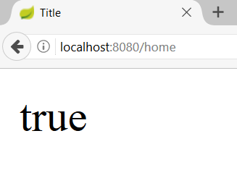
Strings – is Empty
WhiskeyController.java
@GetMapping("/home")
public String getHomePage(Model model) {
String whiskeyNull = null;
model.addAttribute("whiskey", whiskeyNull);
return "whiskey-home";
}
Null/Empty Check
whiskey-home.html
<div th:text="${#strings.isEmpty(whiskey)}"></div>

Slide 12
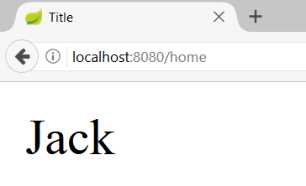
Strings – Substring
WhiskeyController.java
@GetMapping("/home")
public String getHomePage(Model model) {
String whiskey = "Jack Daniels";
model.addAttribute("whiskey", whiskey);
return "whiskey-home";
}
Substring
whiskey-home.html
<div th:text="${#strings.substring(whiskey,0,4)}"></div>

Slide 13
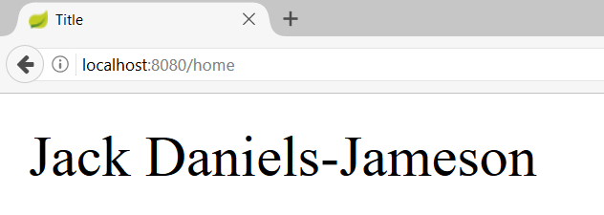
Strings – Join
WhiskeyController.java
@GetMapping("/home")
public String getHomePage(Model model) {
model.addAttribute("whiskeys", whiskeys);
// Jack Daniels, Jameson
return "whiskey-home";
}
Join
whiskey-home.html
<div th:text="${#strings.listJoin(whiskeys,'-')}"></div>

Slide 14
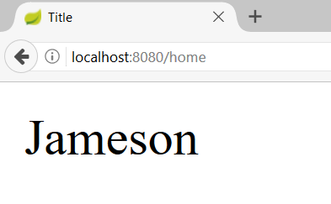
Strings – Capitalize
WhiskeyController.java
@GetMapping("/home")
public String getHomePage(Model model) {
String whiskey = "jameson";
model.addAttribute("whiskey", whiskey);
return "whiskey-home";
}
Capitalize
whiskey-home.html
<div th:text="${#strings.capitalize(whiskey)}"></div>

Slide 15
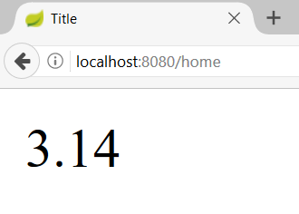
Numbers – Format
MathController.java
@GetMapping("/home")
public String getHomePage(Model model) {
double num = 3.14159;
model.addAttribute("num", num);
return "home";
}
Format
home.html
<div th:text="${#numbers.formatDecimal(num,1,2)}"></div>

Slide 16
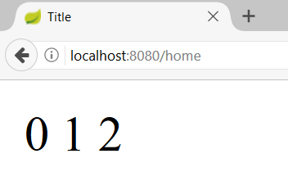
Numbers – Sequence
MathController.java
@GetMapping("/home")
public String getHomePage(Model model) {
return "home";
}
Sequence
home.html
<span th:each="number: ${#numbers.sequence(0,2)}">
<span th:text="${number}"></span>
</span>

Slide 17
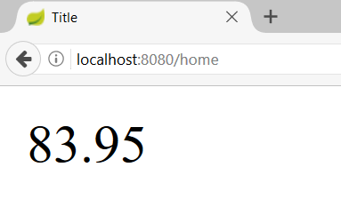
Aggregates – Sum
WhiskeyController.java
@GetMapping("/home")
public String getHomePage(Model model) {
double[] whiskeyPrices = new double[]{29.23, 21.22,33.50};
model.addAttribute("whiskeyPrices",whiskeyPrices);
return "whiskey-home";
}
Sum
whiskey-home.html
<div th:text="${#aggregates.sum(whiskeyPrices)}

Slide 18
Thymeleaf in JavaScript
JSController.java
@GetMapping("/js")
public String getMapPage(Model model){
String message = "Hi JS!";
model.addAttribute("message", message);
return "page";
}
script.js
<script th:inline="javascript">
let message = [[${message}]]; <script>

Slide 19

How to Validate?

Slide 20
Spring Validation & Thymeleaf
Making a simple Model validation and Error rendering
SomeModel.java
SomeController.java
public class SomeModel {
@NotNull
@Size(min = 3, max = 10,
message = "Invalid name")
private String name;
}
Adding a model to the view
@Controller
public class SomeController {
@GetMapping("/add")
public String getPage(Model model) {
if(!model.containsAttribute("bindingModel"){
model.addAttribute("bindingModel",
new BindingModel());
}
return "add";
}
}

Slide 21
Spring Validation & Thymeleaf
Making a simple Model validation and Error rendering
Validate the model
SomeController.java
@PostMapping("/add")
public String add (@Valid @ModelAttribute("bindingModel") SomeModel bindingModel, BindingResult bindingResult, RedirectAttributes rAtt) {
if(bindingResult.hasErrors()){
rAtt.addFlashAttribute("bindingModel", bindingModel);
rAtt.addFlashAttribute( "org.springframework.validation.BindingResult.SomeModel", bindingResult);
return "redirect:/add";
}
this.someService.save(bindingModel);
return "redirect:/home";
}
Validation Result

Slide 22
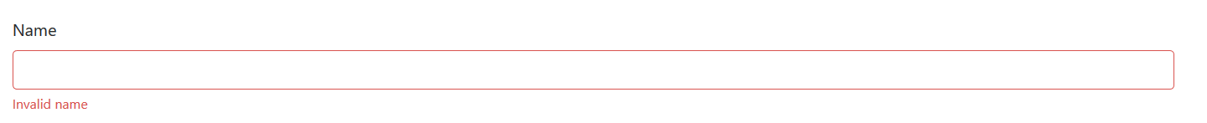
Spring Validation & Thymeleaf
Making a simple Model validation and Error rendering
Set Binding Model
add.html
<div th:object="${productBindingModel}" >
<div class="justify-content-center">
<label for="name" class="h4 mb-2 text-white">Name</label>
</div>
<input th:field="*{name}" th:errorclass="bg-danger" type="text" class="form-control" id="name" name="name"/>
<small th:if="${#fields.hasErrors('name')}"
th:errors="*{name}" class="text-danger"> Name error</small>
</div>
Access Field
Render Error

Slide 23
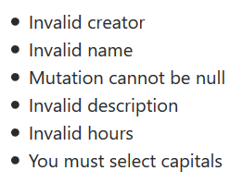
List All Errors
add.html
<ul th:if="${#fields.hasErrors('*')}">
<li th:each="err : ${#fields.errors('*')}" th:text="${err}">
Input is incorrect
</li>
</ul>
add.html
<ul th:if="${#fields.hasErrors('${someModel.*}')}">
<li th:each="err : ${#fields.errors('${someModel.*}')}" th:text="${err}">
Input is incorrect
</li>
</ul>

Slide 24
Custom Annotations (1)
You can also implement custom validation annotations
Sometimes it is necessary due to complex validation functionality
PresentOrFuture.java
@Retention(RetentionPolicy.RUNTIME)
@Target(ElementType.FIELD)
@Constraint(validatedBy = PresentOrFutureValidator.class)
public @interface PresentOrFuture {
String message() default "Invalid Date";
Class<?>[] groups() default {};
Class<? extends Payload>[] payload() default {};
}

Slide 25
Custom Annotations (2)
You will have to implement a custom validator too
add.html
Annotation
public class PresentOrFutureValidator implements ConstraintValidator<PresentOrFuture, Date> {
@Override
public boolean isValid(Date date,
ConstraintValidatorContext constraintValidatorContext) {
Date today = new Date();
return date.after(today);
}
}
Field Type
True = No Error; False = Error

Slide 26

Summary
Objects that provide built-in functionalities that helps you enhance your view
Thymeleaf provides helpers and validations
Making a simple Model validation and Error rendering

Slide 27
Questions?
Notes:
27

Slide 28










SoftUni Diamond Partners

Slide 29



Educational Partners

Slide 30
Trainings @ Software University (SoftUni)
Software University – High-Quality Education, Profession and Job for Software Developers
softuni.bg, about.softuni.bg
Software University Foundation
softuni.foundation
Software University @ Facebook
facebook.com/SoftwareUniversity
Software University Forums
forum.softuni.bg
Notes:
30

Slide 31

License
This course (slides, examples, demos, exercises, homework, documents, videos and other assets) is copyrighted content
Unauthorized copy, reproduction or use is illegal
© SoftUni – https://about.softuni.bg/
© Software University – https://softuni.bg
Notes:
31

